Slide 1
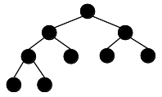
Balanced Binary Trees
http://pineal.github.io/2014/09/Heap/

Slide 2
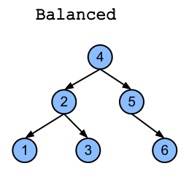
Balanced Binary Trees
a binary tree is balanced if a leaf is not “too much farther” from the root than any other leaf
various balancing schemes allow for different definitions of “too much farther”
Binary Trees
http://www.stoimen.com/blog/wp-content/uploads/2012/06/10.-Balanced-or-not.png

Slide 3
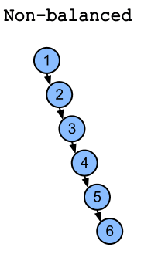
Chains
a tree that is a chain (or almost a chain) is not balanced
a chain has height linear in n
search time linear in n
Full trees and chains represent the two extremes of the spectrum in balanced trees
Binary Search Trees
http://pineal.github.io/2014/09/Heap/

Slide 4
Example
suppose we have a full tree of height 3
  level 0 : 1 node
  level 1 : 2 nodes
  level 2 : 4 nodes
  level 3 : 8 nodes
n = total number of nodes = 15 = 2⁴ – 1
height = floor(log₂15) = floor (3.91) = 3
height + 1
Binary Search Trees

Slide 5
Maintaining Balance
because balanced binary search trees (BST) are efficient to search, we need to maintain a balanced tree
however, even if we start with a balanced tree, insertions and deletions alter the shape of the tree
Binary Trees

Slide 6
Maintaining Balance
the general idea is that elements are inserted or removed in the usual way, but at various points, the tree is re-balanced to ensure efficient search time
we have already covered how to insert elements into a BST
Binary Trees

Slide 7
Maintaining Balance
now we will look at how to remove elements from a BST in such a way that, after removal of an element, the tree still has the required properties of a binary search tree
then we will look at how to maintain a balanced tree as we insert and delete elements
Binary Search Trees

Slide 8
Removing Elements From BSTs
to remove an element we will use the following process
  if the element is a leaf we simply delete it (change the field that references the element to null)
Binary Search Trees

Slide 9
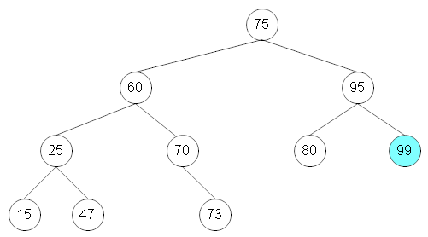
Example – Leaf Delete
  remove the leaf node 99 from the tree shown here
Binary Search Trees

Slide 10
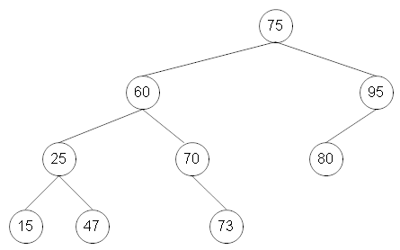
Solution – Leaf Delete
Binary Search Trees

Slide 11
Removing Elements From BSTs
if the element to be deleted has a single child,
we simply link the child to the parent of the element
Binary Search Trees

Slide 12
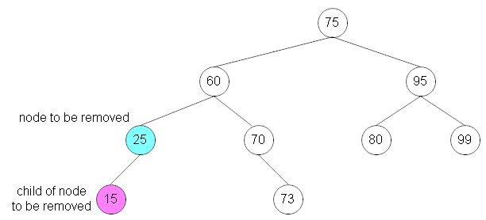
Example 1 – Delete w/1 child
  remove node 25 from the tree shown here
Binary Search Trees

Slide 13
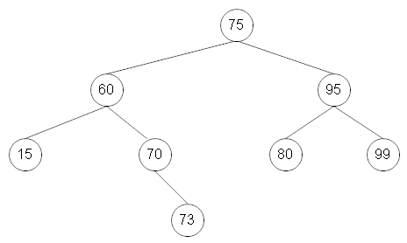
Solution 1 – Delete w/1 child
  removed node 25
Binary Search Trees

Slide 14
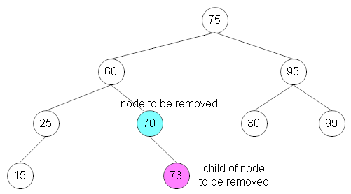
Example 2 – Delete w/1 child
  remove node 70 from the tree shown here
Binary Search Trees

Slide 15
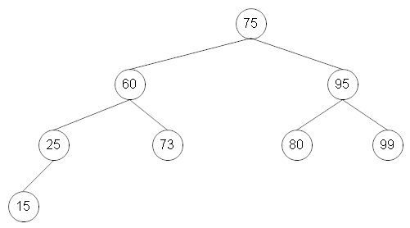
Solution 2 – Delete w/1 child
  removed node 70
Binary Search Trees

Slide 16
Removing Elements From BSTs
removing an element with 2 children is trickier
  1. Replace element with its immediate successor (the element immediately following in an inorder traversal)
    the immediate successor will have no left child (otherwise it cannot be the immediate successor)
Binary Search Trees

Slide 17
Removing Elements From BSTs
  2. Remove the immediate successor
  this is easy, because the immediate successor has no left child and therefore is either a leaf or has only a single child
Binary Search Trees

Slide 18
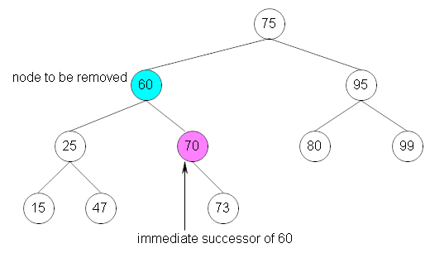
Example – Delete w/2 children
remove node 60 from the tree
1. Replace node 60 with its immediate successor
Binary Search Trees

Slide 19
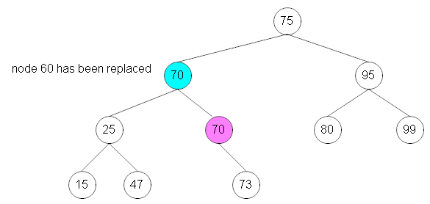
Example – Delete w/2 children
the resulting tree looks like this
Binary Search Trees

Slide 20
Example – Delete w/2 children
2. remove the immediate successor
  node 70 (rose-colored in the previous slide
  node 70 has one child, so we remove it simply by linking its child (73) to the new node 70
  the resulting tree is shown on the next slide
Binary Search Trees

Slide 21
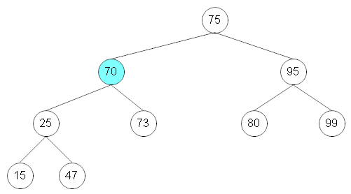
Example – Delete w/2 children
Binary Search Trees

Slide 22
Effect of Insertions and Deletions
note that the shape of a tree changes as we insert and delete nodes
a tree that is balanced may become unbalanced after repeated insertions and deletions
Binary Search Trees

Slide 23
Maintaining Balance
the general idea is that elements are inserted or removed as described previously
at various points, the tree is re-balanced to ensure efficient search time
Binary Search Trees

Slide 24
Rotations
balancing algorithms employ rotations as a means of rebalancing a tree
rotations can either be right rotations or left rotations
Binary Search Trees

Slide 25
Right Rotations
in a right rotation of an element
  the element is moved to where its right child would be
  the left child is moved to where the element was
  if the left child (of the element to be rotated) has a right child,
    left child’s right child → left child of rotated element
Binary Search Trees

Slide 26
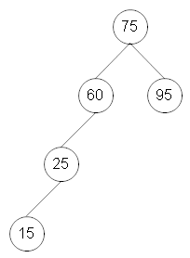
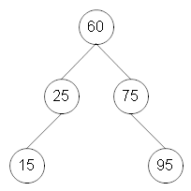
Example – no LC RC
rotate right around 75 (60 has no RC)
Binary Search Trees

Slide 27
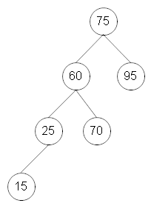
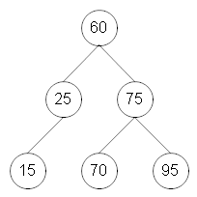
Example – with LC RC
rotate right around 75 (60 has a RC)
Binary Search Trees

Slide 28
Left Rotations
left rotations are symmetrical to right rotations
  the element is moved to where its left child would be
  the right child is moved to where the element was
  if the right child of the element to be rotated has a left child
    right child’s left child → right child of the rotated element
Binary Search Trees

Slide 29
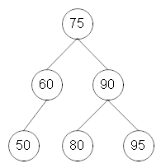
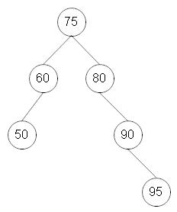
Example – no RC LC
rotate left around 80 (90 has no LC)
Binary Search Trees

Slide 30
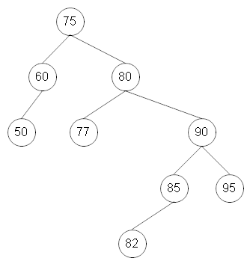
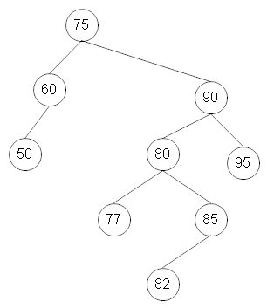
Example
rotate left around 80 (90 has a LC)
Binary Search Trees

Slide 31
Double Rotations
sometimes double rotations are required
  two left rotations
  two right rotations
  a left rotation followed by a right rotation
  a right rotation followed by a left rotation
Binary Search Trees

Slide 32
Self-Balancing BSTs
there are two special categories of trees that are balanced or almost balanced
  AVL trees
    Balanced
    slower insert/removal
    faster retrieval
  Red-Black trees
    approximately balanced
Binary Search Trees

Slide 33
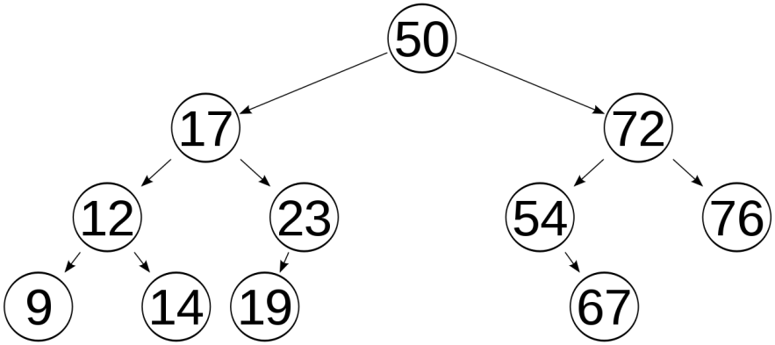
AVL Trees
AVL tree is a self-balancing BST
More rigidly balanced
Either empty or
  the height of the left and right subtrees differ by at most 1
  the left and right subtrees are AVL trees
height is logarithmic in n
Binary Search Trees
https://en.wikipedia.org/wiki/AVL_tree#/media/File:AVLtreef.svg

Slide 34
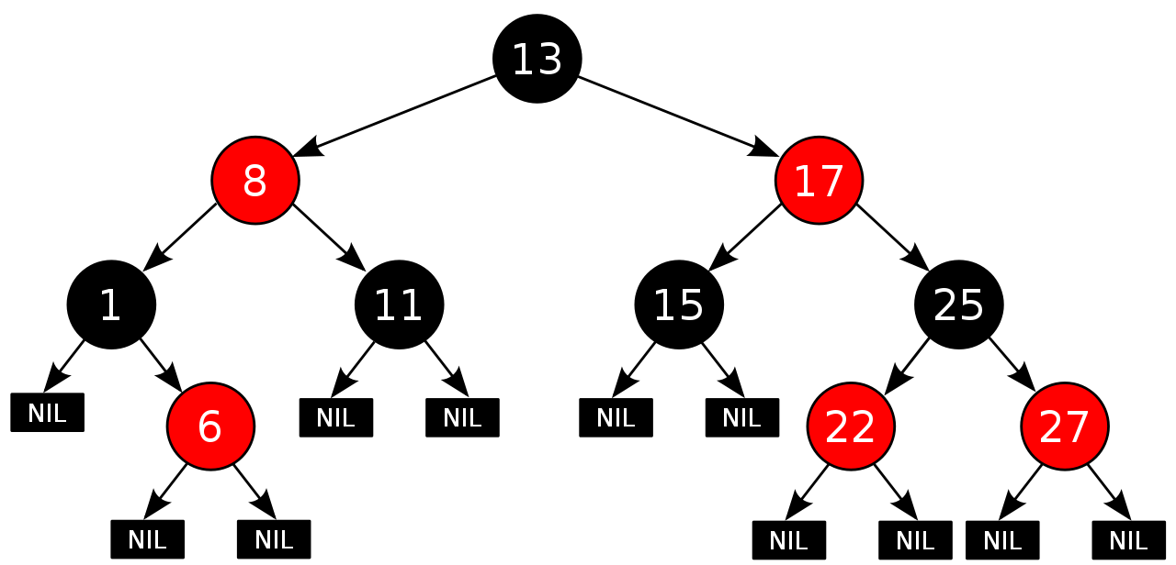
Red-Black Trees
Red-Black tree is a self-balancing BST
approximately balanced, extra bit for color
height is logarithmic in n
the TreeMap class is based on a red-black tree implementation
both red-black trees and AVL trees use rotations to maintain balance
https://en.wikipedia.org/wiki/Red%E2%80%93black_tree#/media/File:Red-black_tree_example.svg
Binary Search Trees

Slide 35
Balanced Binary Trees
The End
http://pineal.github.io/2014/09/Heap/

